Slide 1
Stock Price Prediction
Sulav Dhakal

Slide 2

Introduction
Most of the financial institution make Financial Market transaction, which is investment of stock
Using machine learning it could be much more easier.
The objective of this project is to identify and predict what is the trend of the particular stock price in the time series
2
Stock Price Trends

Slide 3
Problem Statment
Forecasting the stock price
Which stock to pick
Trend analysis
Hard to analyse the trend of stock

Slide 4
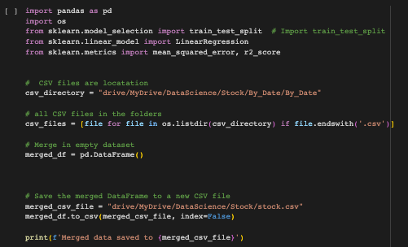
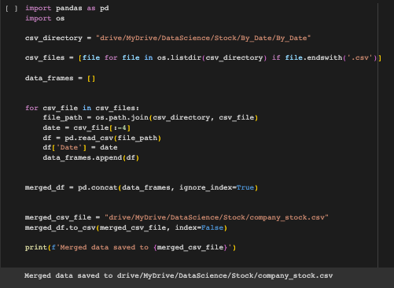
Merge of data set

Slide 5
Dataset Overview
Dataset: Nepal Stock price Dataset
Source: Kaggle & Share sansar
Key Variables:
Napes Index( SN)
Traded Companies
No. Of Transaction
Max Price
Min Price
Amount
Previous Closing
Difference Rs.
Date
5

Slide 6
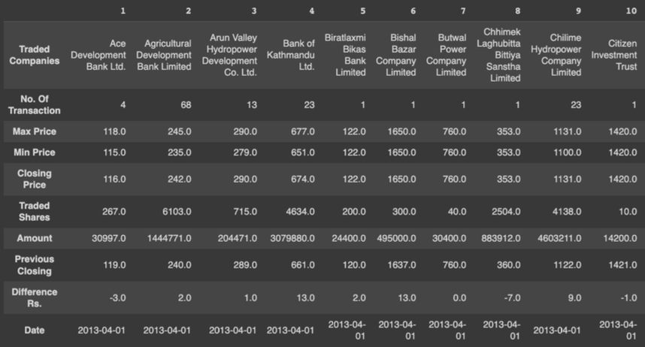
Sample Data
6

Slide 7
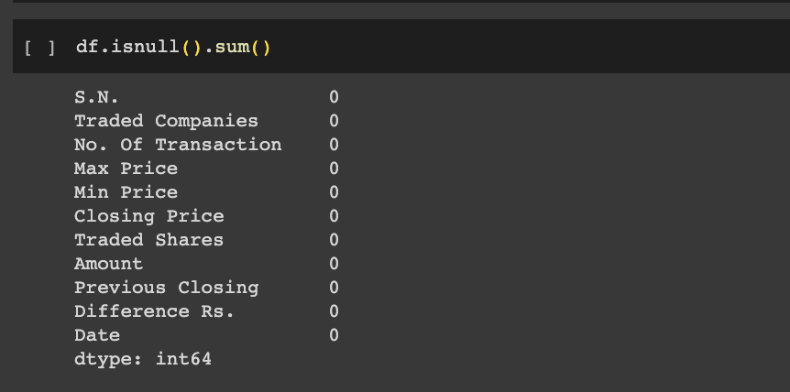
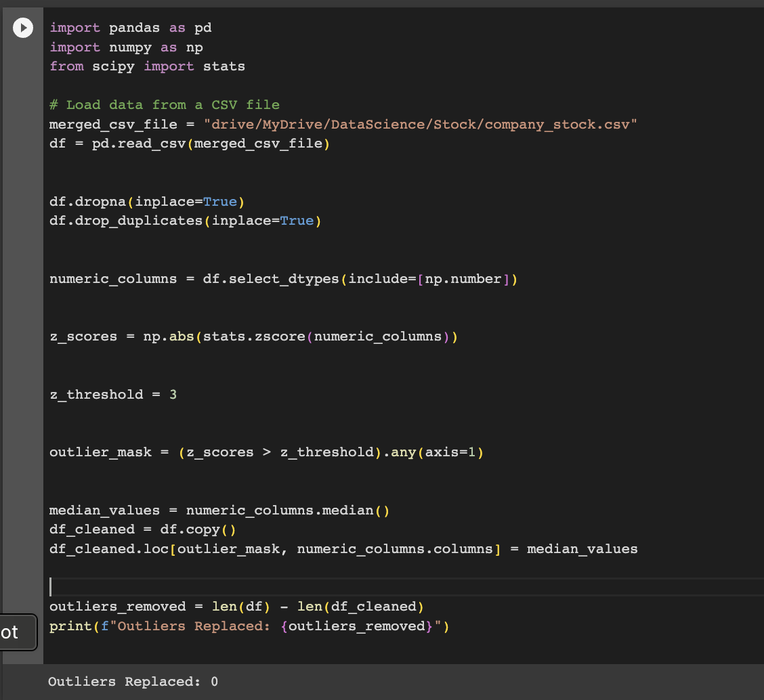
Data Cleaning
Dropping duplicate values
Handling NULL values with mean
Replaced 0 values
Importance of Data Preprocessing
Data quality and consistency
Limited Outliers while analysizing
Model accuracy
Handling of impact from outliers and missing values
7

Slide 8
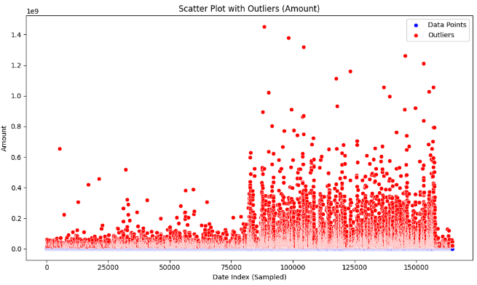
Outliers Detection in the dataset
Outlier Detection Techniques
Z-Score Method
The mean is calculated using the Z-Score
Threshold: Here we set threshold at 2 standard deviations to flag outliers.
Here if the point gets above the mention threshold are considered outliers.
IQR Method
Interquartile range considers the distribution's quartiles to identify outliers.
Calculate IQR as the range between the 25th (Q1) and 75th (Q3) percentiles.
Typically, outliers are data points falling below (Q1 - 1.5 * IQR) or above (Q3 + 1.5 * IQR).

Slide 9
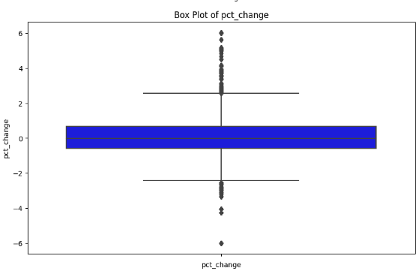
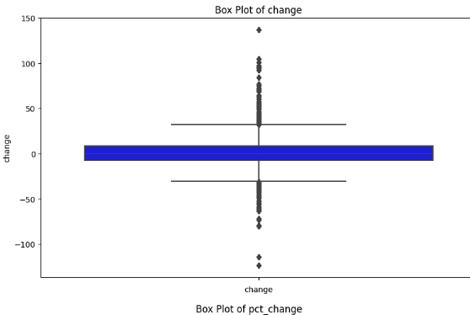
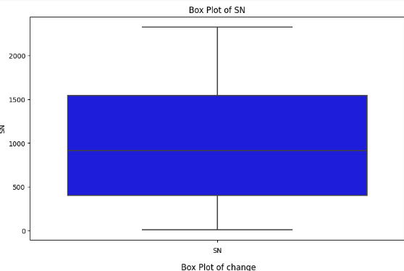
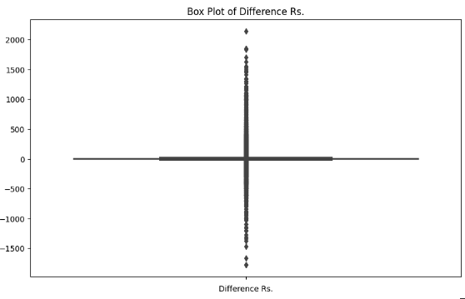
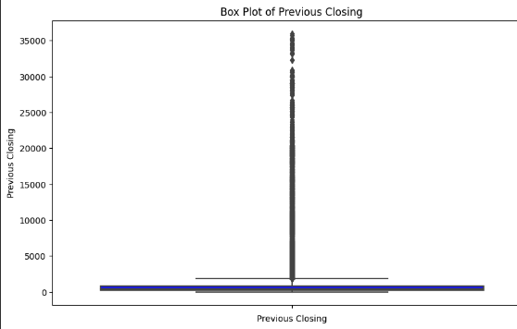
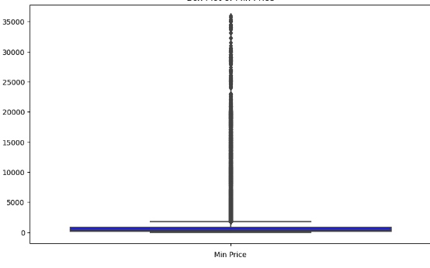
Box Plots Before
Distribution of the cleaned Data after handling outliers.

Slide 10
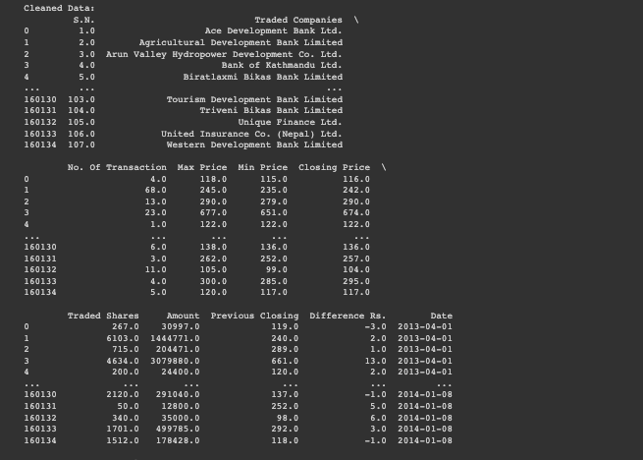
After cleaning data and removing outliers

Slide 11
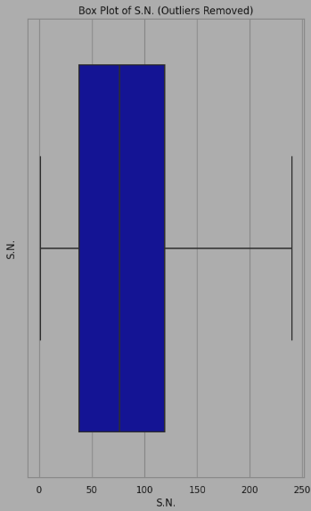
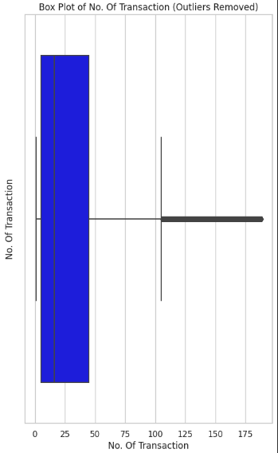
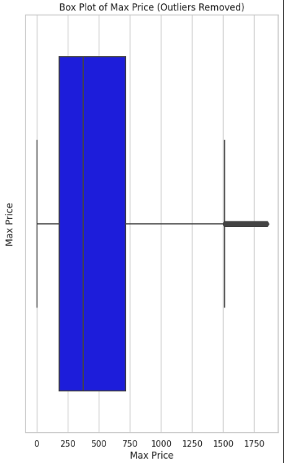
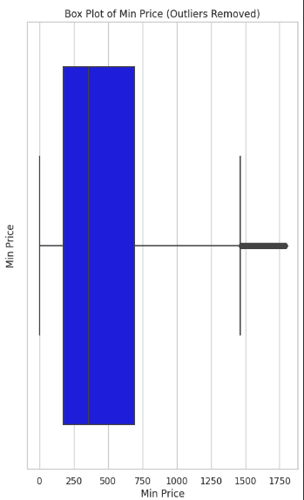
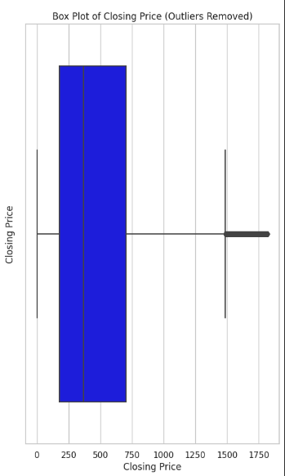
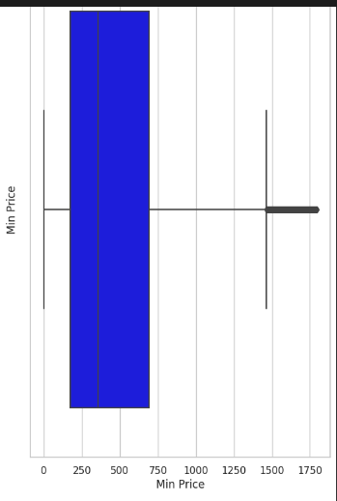
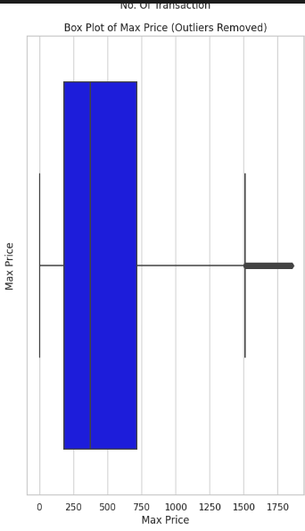
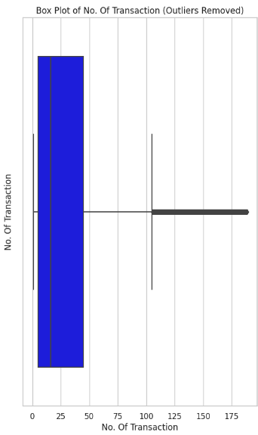
Box Plots After

Slide 12
Data Visualization
Visualizations helps in understanding data distributions, identifying patterns, and recognizing outliers.
Data Visualization Techniques Used:
Histogram Plot
Line Plot
Bar graph Plot

Slide 13
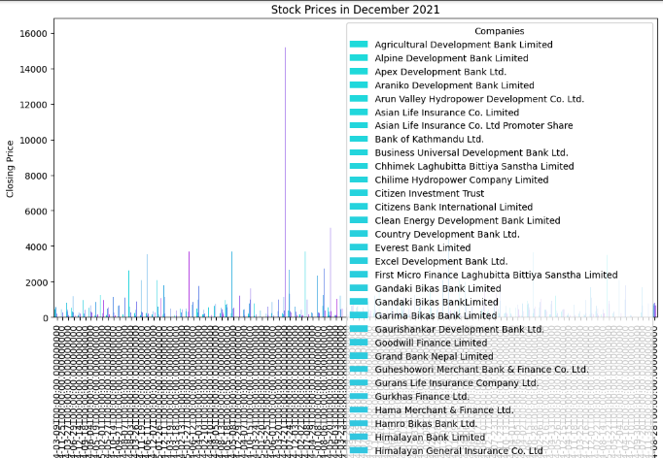
Bar Graph

Slide 14
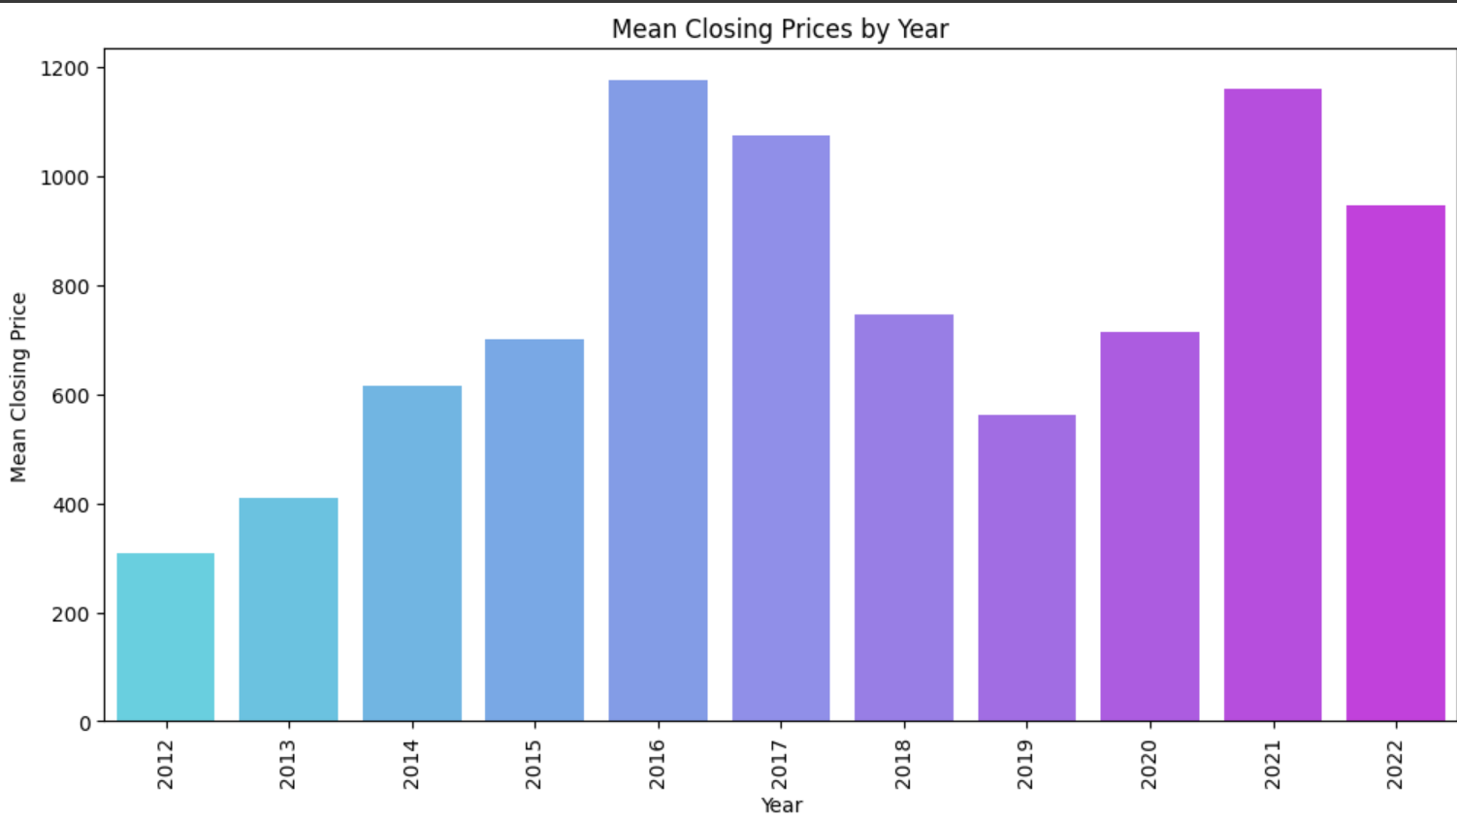
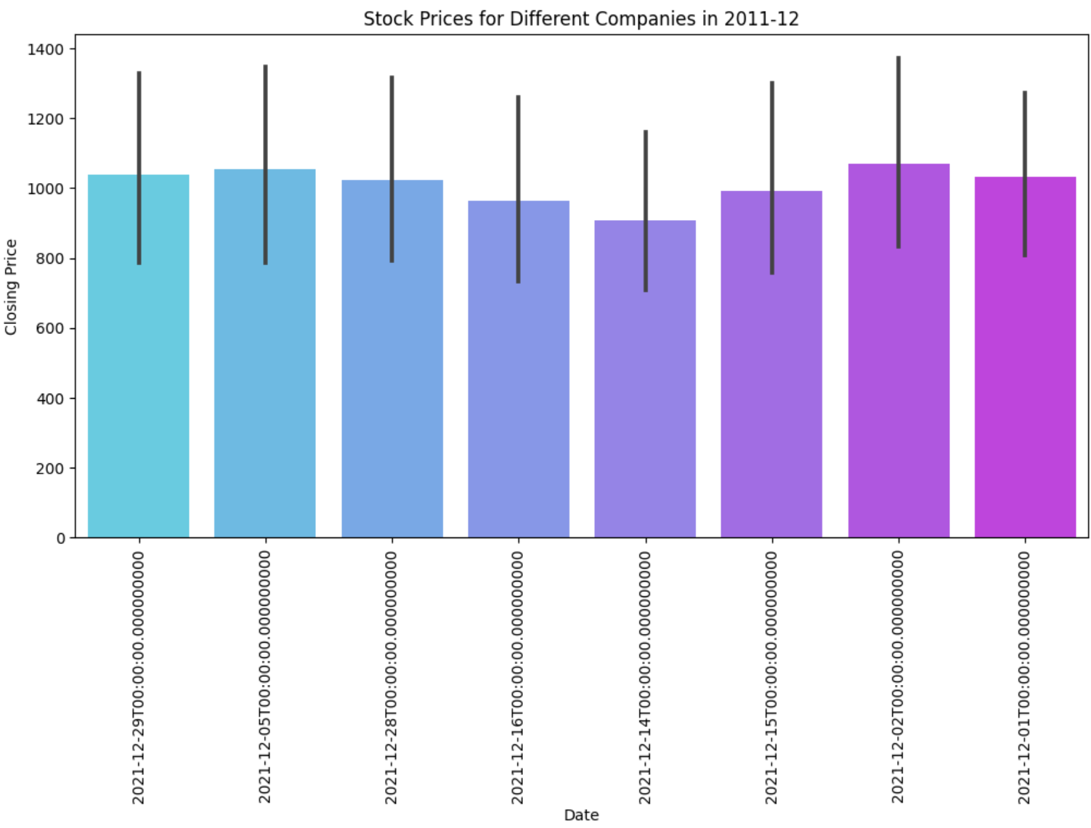

Slide 15
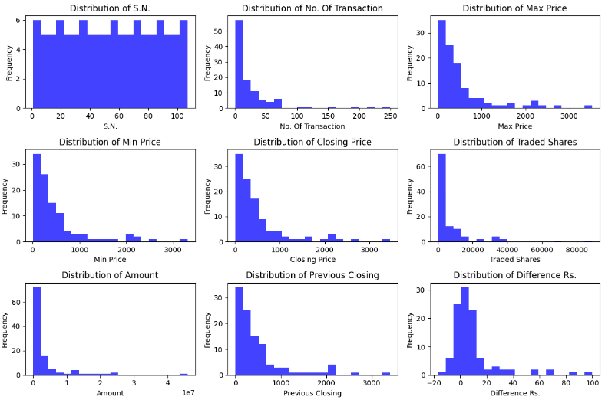
Histogram

Slide 16
Regression
Decision Tree Classifier:
Supervised machine learning algorithm.
Suitable for categorical and numerical data,
Easy to understand and interpret.
Linear Regression:
Assumes a linear relationship between variables.
Primarily used for predictive modeling.
Coefficients represent the impact of independent variables.
Random Forest
Ensemble method that combines multiple decision trees for improved predictive accuracy
Create diverse decision trees by resampling the training data
Helping identify key variables in making predictions

Slide 17
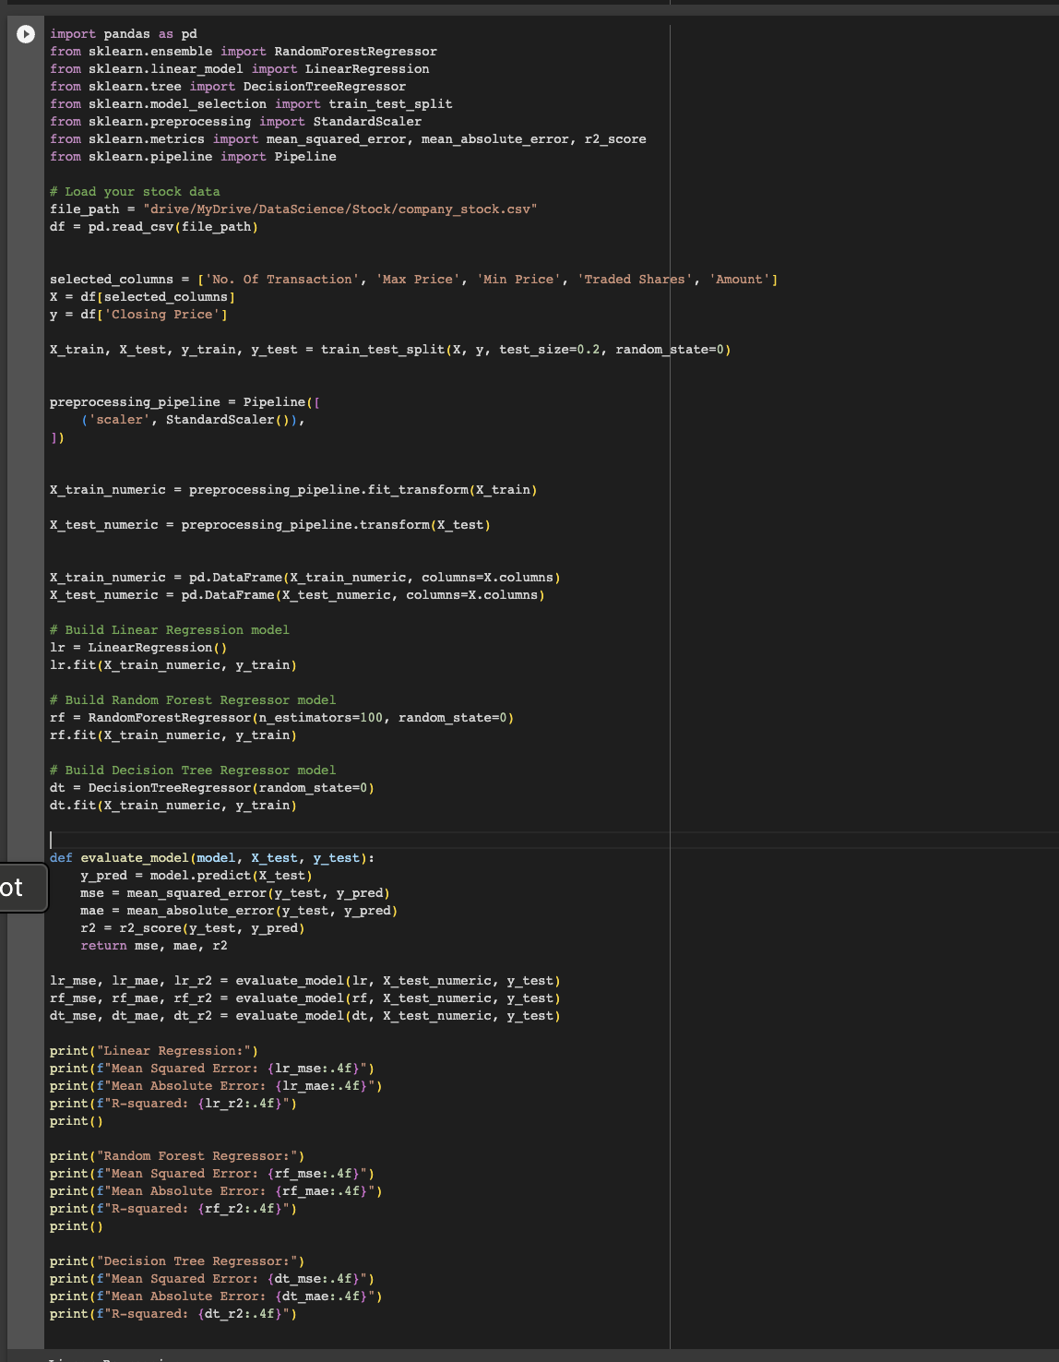
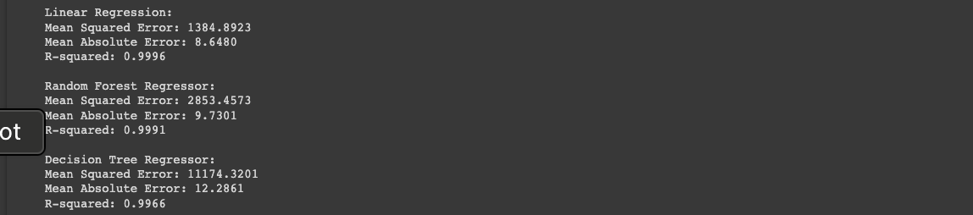
Choosing Correct model
Decision Tree, Random Forest and Linear Regression is used MSE,MAE and R2
Findings:
A more thorough analysis reveals that the
Linear Regression R2 score of 0.99948 is slightly greater
than the Random Forest and Decision Tree Regression.

Slide 18
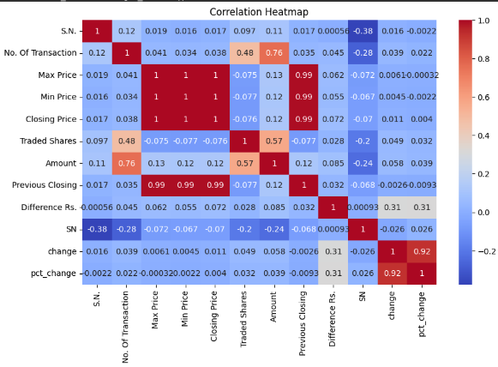
Correlation Matrix
Relationship between numerical features.
Strong positive and negative correlations.
Warmer colors (closer to 1) indicate strong positive correlations.
Cooler colors (closer to -1) indicate strong negative correlations.
Insights help in feature selection and model performance.

Slide 19
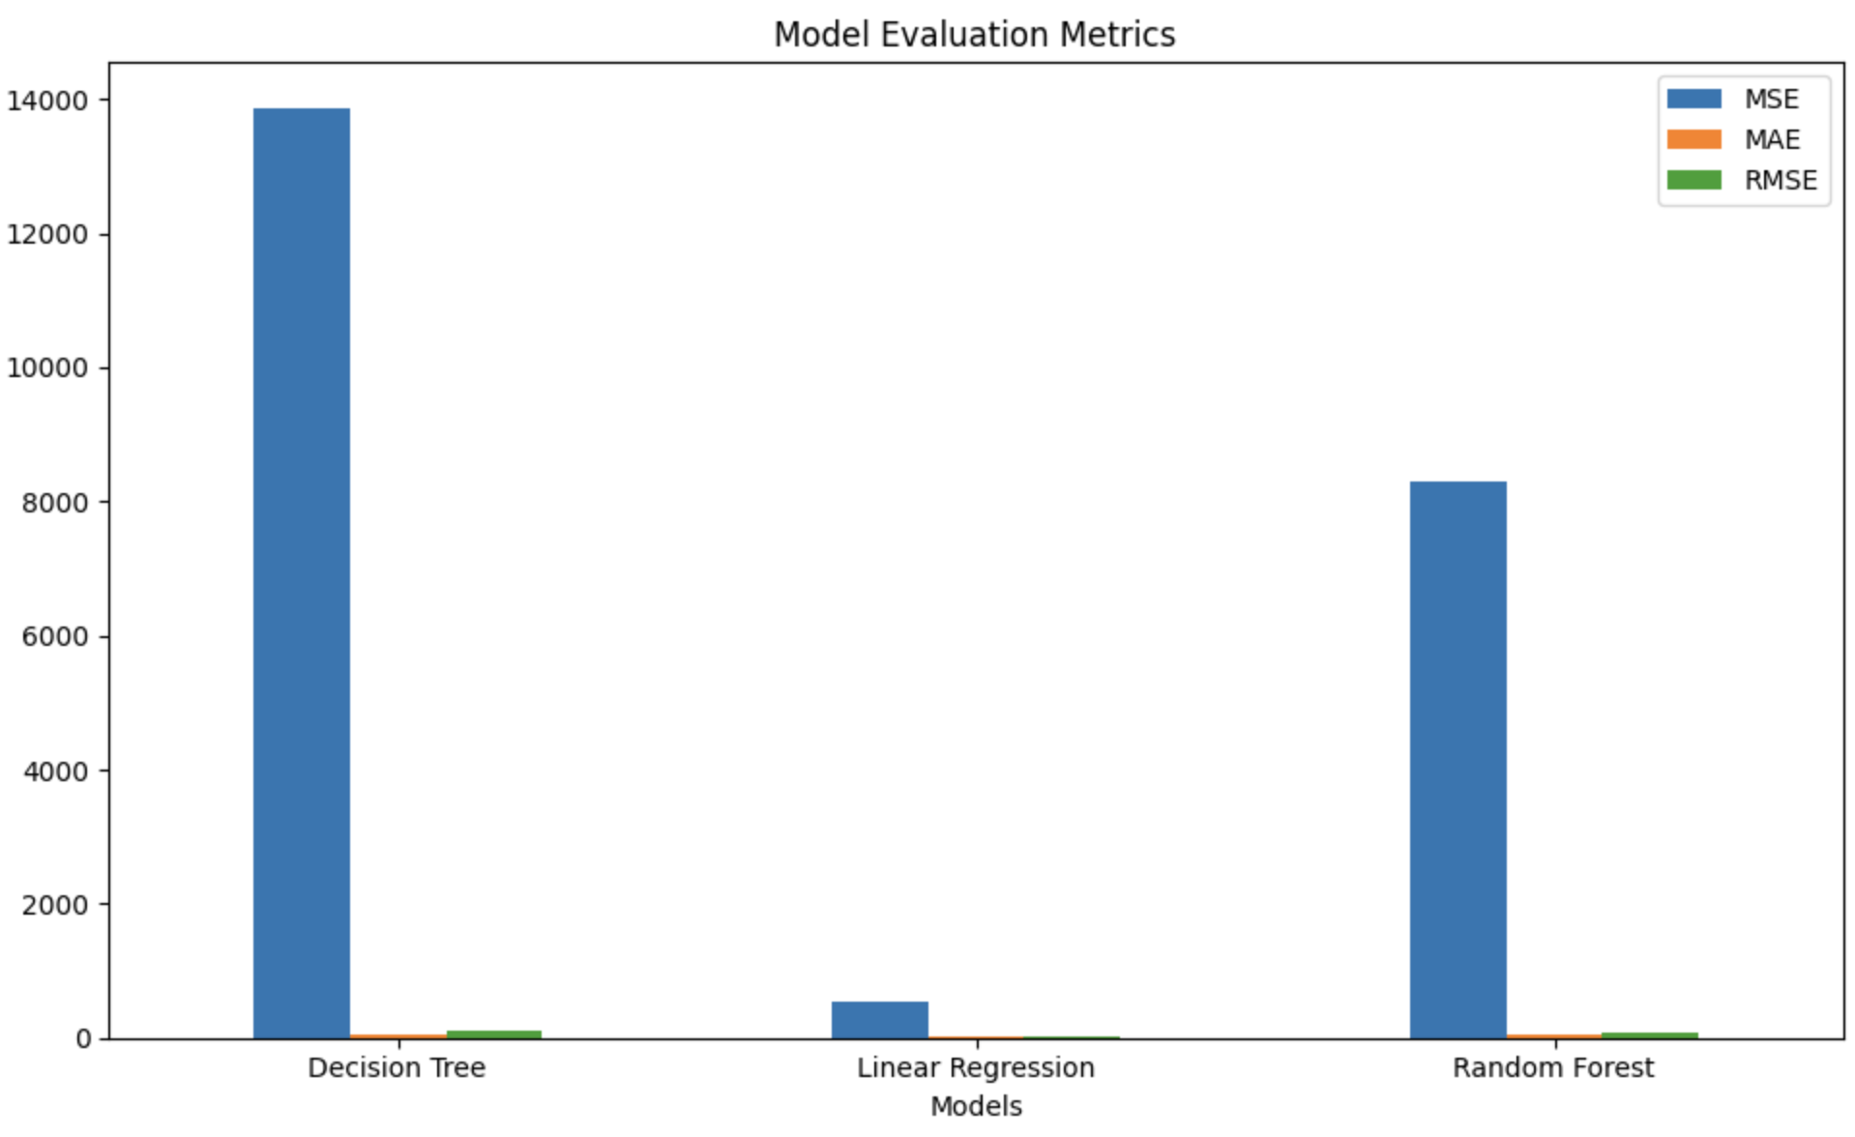
21

Slide 20
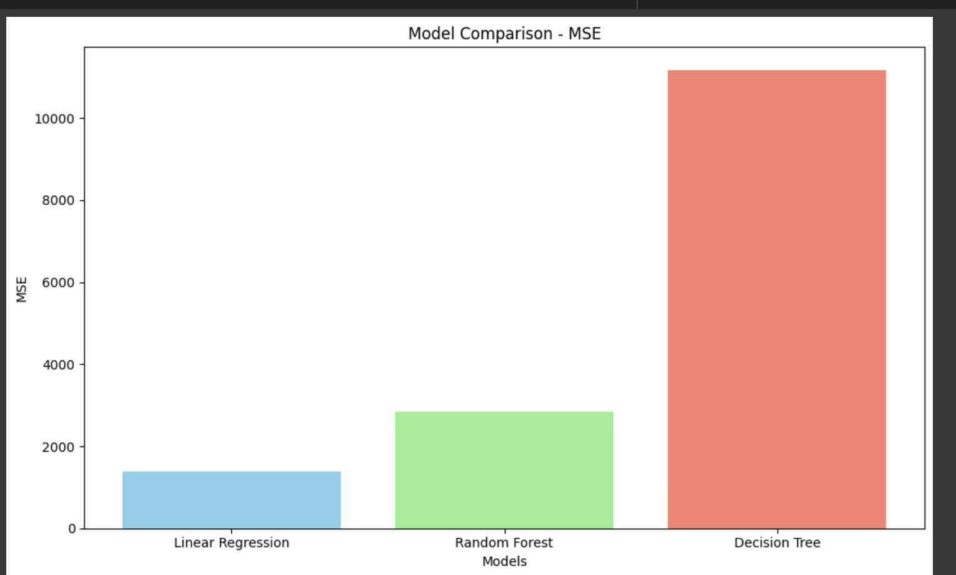
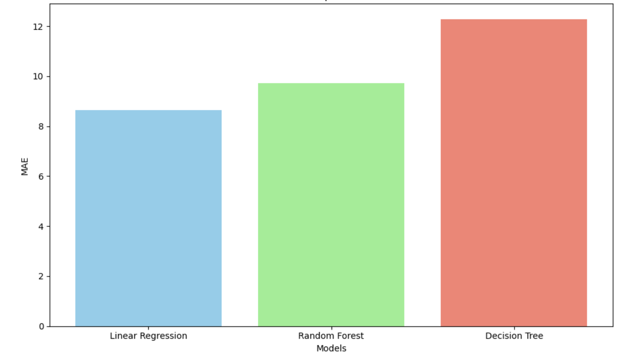

Slide 21
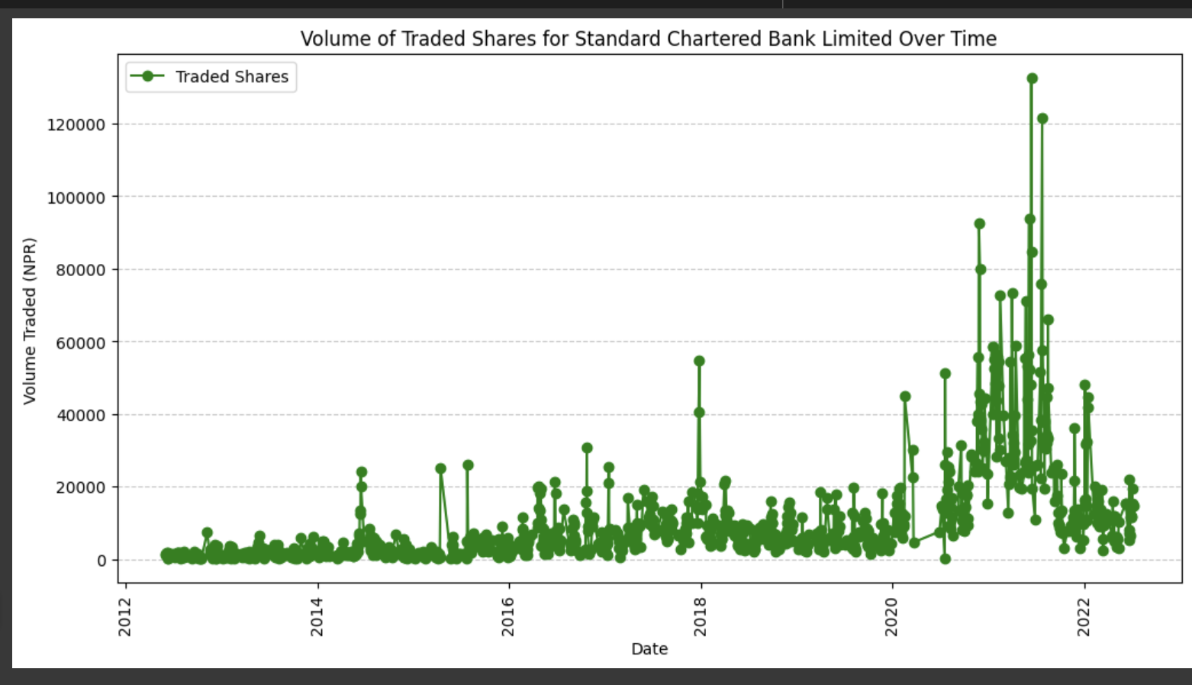
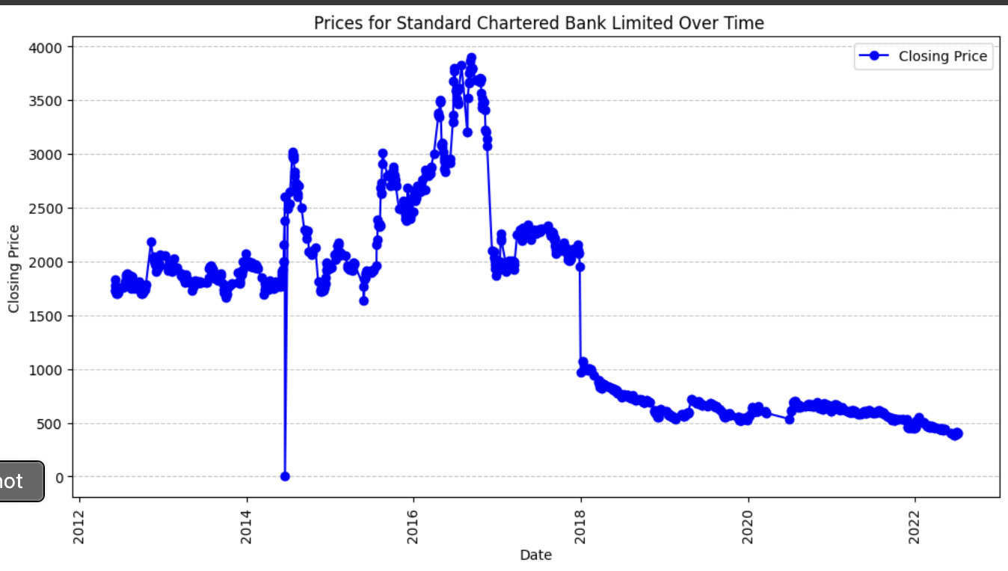
Volumn of SCB trended from 2012 to 2022

Slide 22
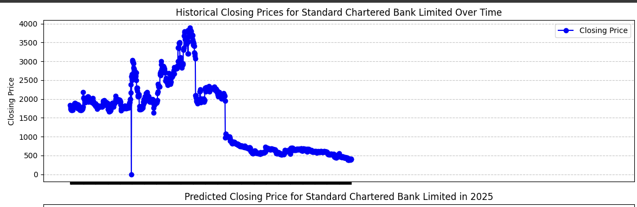
Conclusion
The chosen dataset is in charge
of forecasting SCBN's price.
I chose Linear regression over
classification since regression
is the best fit for continuous
quantitative prediction and the
objective variable in my dataset is
"price” Factor.
Average Predected Price 451.23(till 2025)

Slide 23
References
Guide, S., & Biswal, A. (2023, April 4). Stock Price Prediction Using Machine Learning: An Easy Guide. Simplilearn.com. Retrieved October 2, 2023, from https://www.simplilearn.com/tutorials/machine-learning-tutorial/stock-price-prediction-using-machine-learning
Pokhrel, N. R., Dahal, K. R., Rimal, R. c., & Edward Hahn, W. f. (2019, June 24). . . - YouTube. Retrieved October 2, 2023, from https://doi.org/10.1016/j.mlwa.2022.100385.
Raval, P. (2023, August 30). Stock Price Prediction using Machine Learning with Source Code. ProjectPro. Retrieved October 2, 2023, from https://www.projectpro.io/article/stock-price-prediction-using-machine-learning-project/571
Sharma, P. (2021, October 13). Stock Market Prediction | Predict Stock Market Trends Using ML. Analytics Vidhya. Retrieved October 2, 2023, from https://www.analyticsvidhya.com/blog/2021/10/machine-learning-for-stock-market-prediction-with-step-by-step-implementation/

Slide 24
Thank you

